Slide 1
Community-Building for LGBTQ Youth
Kris Knickerbocker
MSU EPET Program 2012

Slide 2
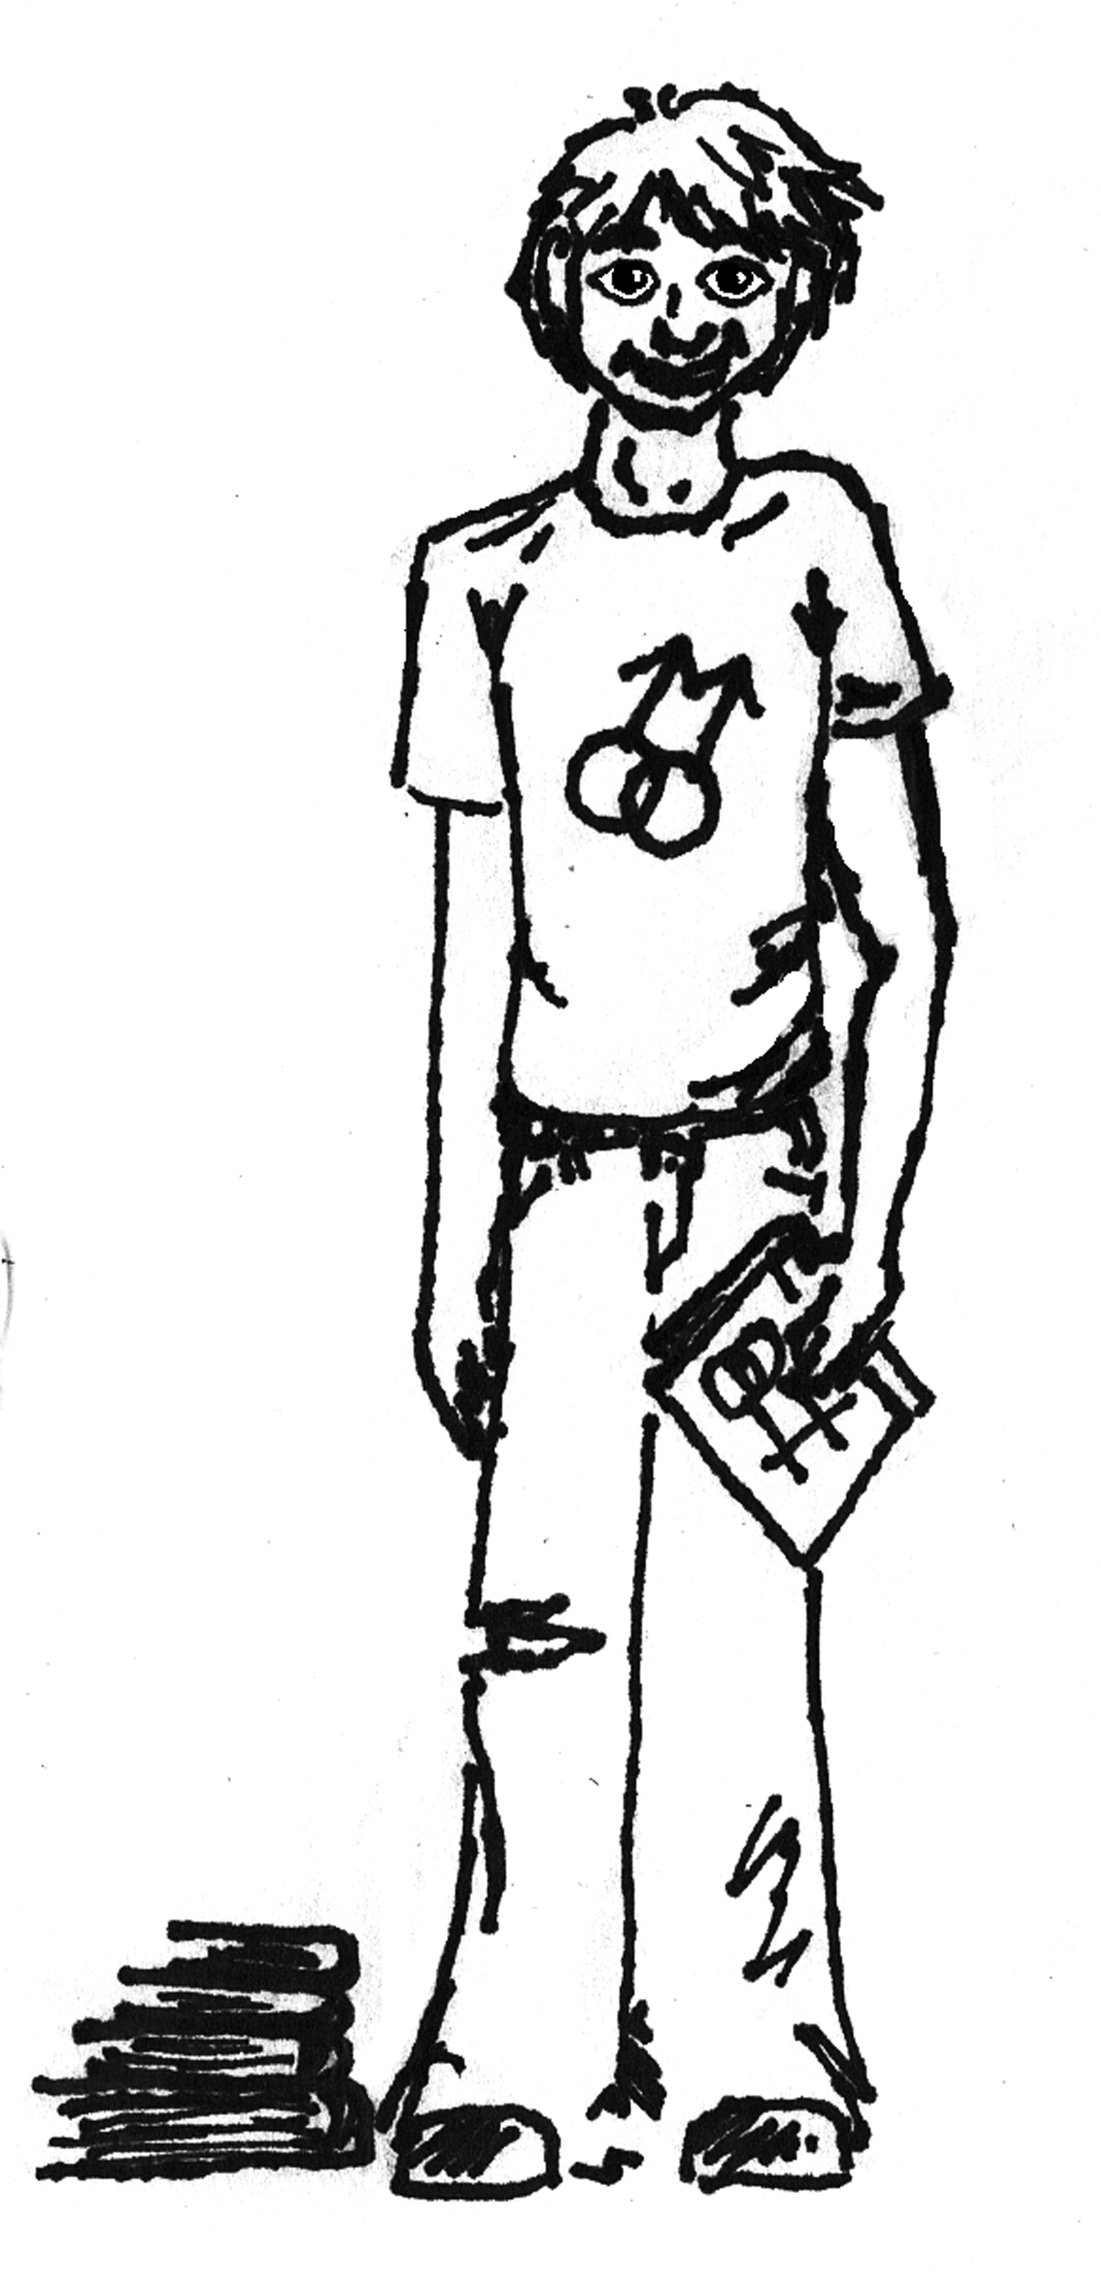
Meet Sue.
Sue is an average teenager, with all of the regular teenage struggles and heartaches.
But Sue has something else to deal with.
Sue is a transgender person. That means he was born with female chromosomes and genitalia, but identifies as a male.
So how does that change Sue’s school experience?
What factors affect his emotional and academic success?
Let’s take a look …

Slide 3
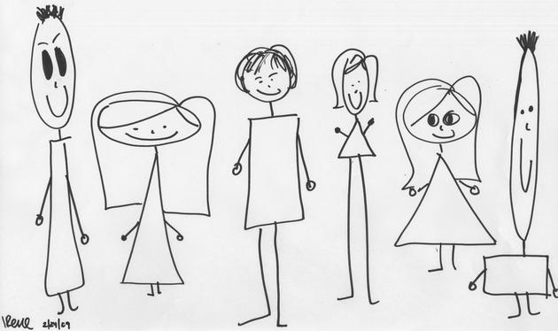
Most high school students fit into “traditional gender roles”. This means they look like what society thinks a “girl” or “boy” should look like.
They are easily identified by their physical characteristics and this makes people around them feel at-ease and comfortable.

Slide 4
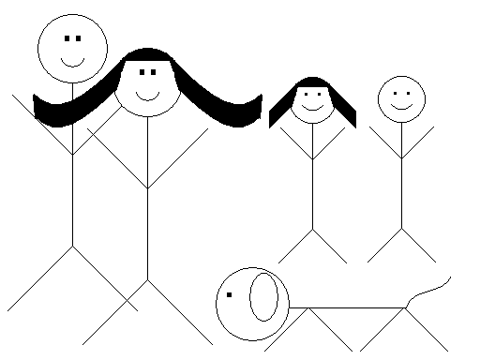
But Sue doesn’t fit the gender binary of “boy” or “girl”. He can’t be easily identified as one sex or the other.
Other students commonly isolate, tease, and even physically intimidate or bully students who they think are lesbian, gay, bisexual, transgender or queer (LGBTQ).
This can feel like social and emotional “death” for the LGBTQ person.

Slide 5
LGBTQ teens often feel as though they’re drowning in their own reality …
Trying desperately to form connections with peers, find acceptance at home and in their communities … even within themselves.
And, on top of all of that, they must find a way to succeed academically.

Slide 6
But Sue, like many of his LGBTQ peers, finds it difficult to participate in class.
When he does, fellow students often tease him.
Even some of his teachers seems to treat him differently, as if they doesn’t understand who Sue is or why he “chooses” to dress like a boy.
Why would any teenager intentionally look different, act different, and BE different?
Herein lies the problem. Sue is being Sue. Sue was born in a female body, but isn’t a female.
So he’s stuck in a world that often doesn’t accept or respect him.

Slide 7
Many teachers think that treating “everyone the same” is the answer.
But equal treatment does not mean equitable treatment.
Sue doesn’t “fit the mold” of the traditional student. He has a unique set of emotional and academic needs.
And if the teachers aren’t comfortable with the gender expression or sexual orientation of an LGBTQ student, the student feels that disconnect. It becomes just one more awkward and strained relationship to work past.

Slide 8
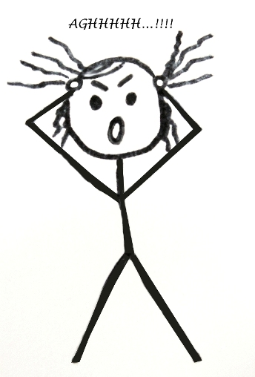
This inevitably leads to frustration …
Hopelessness ….
Isolation …
Fear …
And often problematic substance use and suicidal ideations.
And worst of all, very little support exists for these students. Teachers label them as “bad kids” or “intentional non-learners” because the marginalized students appear uncooperative and non-participatory.

Slide 9
So Sue does what many LGBTQ students resort to …
He runs away. He avoids school. He neglects homework and studying. And he suffers academically.
And this is all due to his inability to fit the strict social expectations that society has established.
So what can he do? How can he find a group of peers like him? Members of HIS community that can relate to his struggles and share his pain.

Slide 10
A place where there are more than 2 accepted gender expressions.
Where non-traditional sexual orientation and gender identity are not taboo subjects, but openly discussed and embraced.
Where a person’s identity is not defined by their biological sex and physical genitalia.

Slide 11
Where he’s not a social outcast.
Where he doesn’t feel so confused, isolated and frustrated.
Where LGBTQ students, like him, can feel connected and valued.

Slide 12
Perhaps the school has a GSA! This is a place where LGBTQ students can build communities of support and acceptance … right?
But many schools don’t even have GSA groups. Those that do are often not inclusive of transgender students. And many students don’t feel comfortable attending. So the isolation continues without remedy.

Slide 13
And there is no open forum to discuss sensitive, embarrassing, and crucial identity issues with accepting peers.
There is no sense of community or belonging.
These students are struggling, failing, and hurting themselves as a result of their hopelessness and loneliness.

Slide 14
So they resort to the technology they know and are comfortable with.
They search the web for people, somewhere in the world, who are like them.
Who share the same struggles and experiences.
Who can give them help and advice.

Slide 15
But the schools stop them with specially designed firewall filters that block LGBTQ content! Why? Because, they argue, these may contain pornographic or inappropriate materials.
But there are other filters, specific to pornography, graphic images, and inappropriate language that are more effective in these measures. Schools are enforcing outdated restrictions with insufficient rationale and hurting LGBTQ students in the process.

Slide 16
If we drop these barriers and open options that allow students access to social networking sites …
They can begin to feel connected, in some way, to others like them. And the world doesn’t feel so very small anymore.
They begin to build a support network. A community of inclusiveness and understanding.

Slide 17
Sue, and others like him, can start to feel empowered and confident. And no longer feel like “the only one” in the world.
His world opens up with new possibilities and opportunities. And he may find it a little easier to plug into his own everyday reality.
LGBTQ students are a vital and important part of our world. Let’s make them a priority and start advocating for their needs.

Slide 18
Research Interest Statement
My research interest focuses on the factors that affect how queer youth function within their educational peer groups. I will examine how social-networking technologies can be utilized to facilitate the formation of positive social relationships for these marginalized students.

Slide 19
CITATIONS I:
http://cornellsun.com/files/images/irene-stick-figures.preview.jpg
http://leavinglaw.files.wordpress.com/2010/10/stick-figure-depressed.jpg
http://www.nassaulibrary.org/centreblog/stick%20figures.gif
http://www.ckw.ac.th/ckwschool/freeware/program/school.discovery.com_clipart_/school.discovery.com/clipart/images/stk-fgr5.gif
http://www.globalnerdy.com/wordpress/wp-content/uploads/2009/05/breaking-desktop-chain.jpg
http://www.toysofanothertime.com/images2/stick%20figure2.JPG
http://static.flickr.com/58/153233393_af843cd51f.jpg
http://www.playbigonlinemarketing.com/wp-content/uploads/2012/05/stick_figure_presenter_display_400_clr.png
http://4.bp.blogspot.com/_XCfuicHRoCE/TCIowC7j__I/AAAAAAAAABw/gV59LDk8Oq8/s1600/br2.jpg
http://practicalandrogyny.com/wp-content/uploads/2011/04/transgender_no_entry.png
http://1.bp.blogspot.com/--OGRLkcoWaE/TmDs2dANIvI/AAAAAAAADhk/V6eE1BxJ7Cw/s1600/6a00d834520aaa69e20105352c4f3d970c-800wi.jpg
http://hearingelmo.files.wordpress.com/2011/05/stick_figure_pic.jpg
http://sas.guidespot.com/bundles/guides_9e/assets/widget_cryW_O1cHpCi60Iy4dVpRw.jpg
http://garneringchange.files.wordpress.com/2010/01/confused.jpg
http://ciphermagazine.com/blog/wp-content/uploads/2011/12/LGBT.jpg
http://albafigueroa.com/wp-content/uploads/2010/12/stick_figure_drawing_people_leader_400_clr.png

Slide 20
CITATIONS II:
http://eusoqueriaestudar.files.wordpress.com/2011/06/wdys_stick_figures.jpg
https://www.fairviewhs.org/system/photos/58/original/gsa.gif?1327383360
http://us.cdn3.123rf.com/168nwm/michaeldb/michaeldb1008/michaeldb100800051/7615737-a-group-of-stick-figure-symbol-people-talk-in-social-media-speech-bubbles.jpg
http://us.cdn4.123rf.com/168nwm/michaeldb/michaeldb0905/michaeldb090500001/4950302-gradient-blend-of-diverse-group-of-symbol-people-of-many-colors-hold-their-hands-up-in-a-ring.jpg
http://us.cdn4.123rf.com/168nwm/michaeldb/michaeldb1011/michaeldb101100022/8220606-a-team-or-company-of-3d-stick-figure-symbol-people-connect-in-nodes-of-a-business-network-drawn-on-l.jpg
http://visionhelp.files.wordpress.com/2011/01/stick_figure_working_laptop_desk.gif
http://www.yalealumnimagazine.com/blog/wp-content/uploads/2011/02/Screen-shot-2011-02-24-at-10.38.34-AM.png
http://www.schoollibraryjournal.com/articles/images/SLJ/20090817/aclu.jpg
http://nursingcrib.com/wp-content/uploads/online-learning.jpg?9d7bd4
http://reactimg.com/images/14.jpg
http://l.thumbs.canstockphoto.com/canstock3524097.jpg
http://www.prayerthoughts.com/prayerthoughts/Spiritual_Warfare/images/pt387_global_stick_figure_europe_africa_asia_400_wht%20copy-300.png

